Slide 1


Cookie Consent Project
Kick-off
January 27, 2022

Slide 2
Cookie Consent Program |
WARNING!
If you have no products with Cookies, you do not need to be on this call

Slide 3
Cookie Consent Program | Agenda
    Why this session?
      Stream of Cross-Functional Projects (Planned or Unplanned)
      Organizational alignment
      Increase where possible advanced notice of projects and expectations
      More efficient; PI planning, Sprint planning, resource management and budgeting
    Cookie consent program overview and Approach
    Meet the Teams
    Onboarding and Remediation
    Timing and Project Management
    Q & A

Slide 4
Cookies Consent Overview and Approach

Slide 5
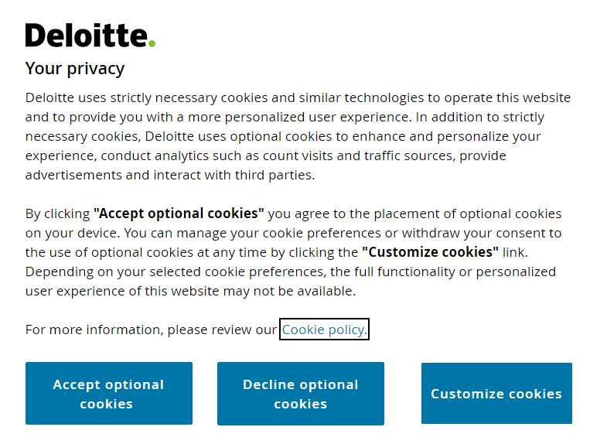
Cookie Consent Program | Introduction
    What are cookies?
    A cookie is a small text file placed on a user's device by the websites that the user visits. Cookies are then sent back to the website on each subsequent visit, or to another webpage that recognizes that cookie or other similar web tracking technologies (such as web beacons, tags, scripts, local storage).
    Why am I seeing a notification about cookies on every website I visit?
  Many jurisdictions around the world have established a higher standard for providing notice and obtaining applicable consent from individuals prior to placing cookies and other similar web tracking technologies (e.g., web beacons, tags, scripts, local storage) on their devices. Applications must be compliant with these regulations or risk fines resulting in damage to brand and reputation.
Image sourced from Deloitte.com global site; exact wording will vary across member firms.

Slide 6
Cookie Consent Program | Overview
Many jurisdictions around the world have established a higher standard for providing notice and obtaining consent from individuals prior to placing cookies and other similar web tracking technologies (e.g., web beacons, tags, scripts, local storage) on their devices.
Compliance requirements for cookies set forth in various regulations:
  General Data Protection Regulation (GDPR)
  European E-Privacy Directive Article 5 (3)
  France 2019 Guidelines relating to Article 82 of the French Data Protection Act which requires organizations to obtain consent before placing cookies on users’ devices
  UK Privacy and Electronic Communications Regulations (PECR)
  As of October 1, 2019, the European Court of Justice (CJEU) ruled in the ‘Planet 49’ landmark case that users must affirmatively ‘Opt-in’ to cookies before they are placed
Applications must be compliant with these regulations or risk fines resulting in damage to brand and reputation.

Slide 7
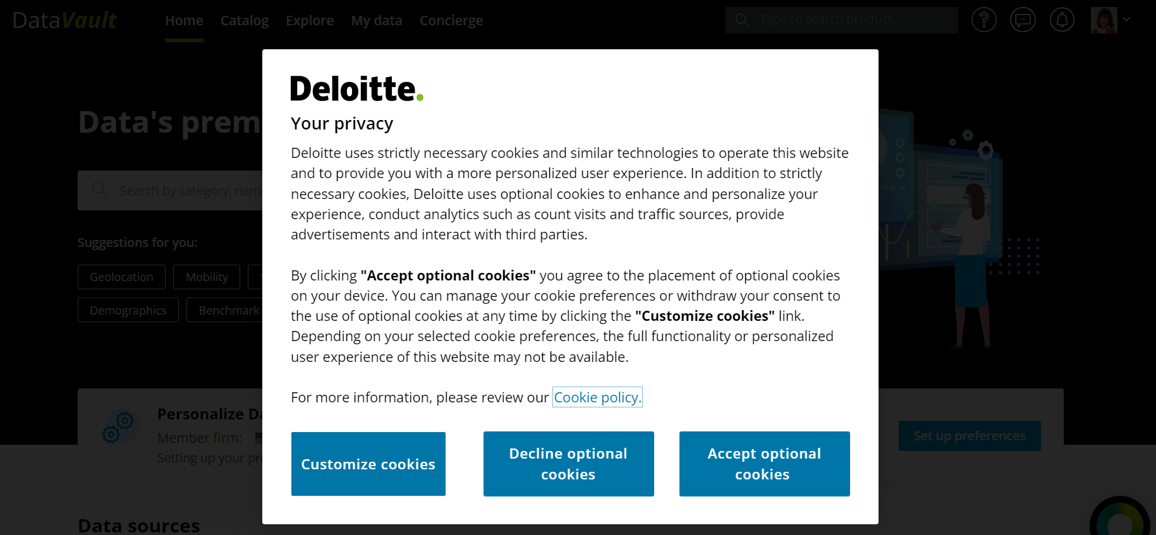
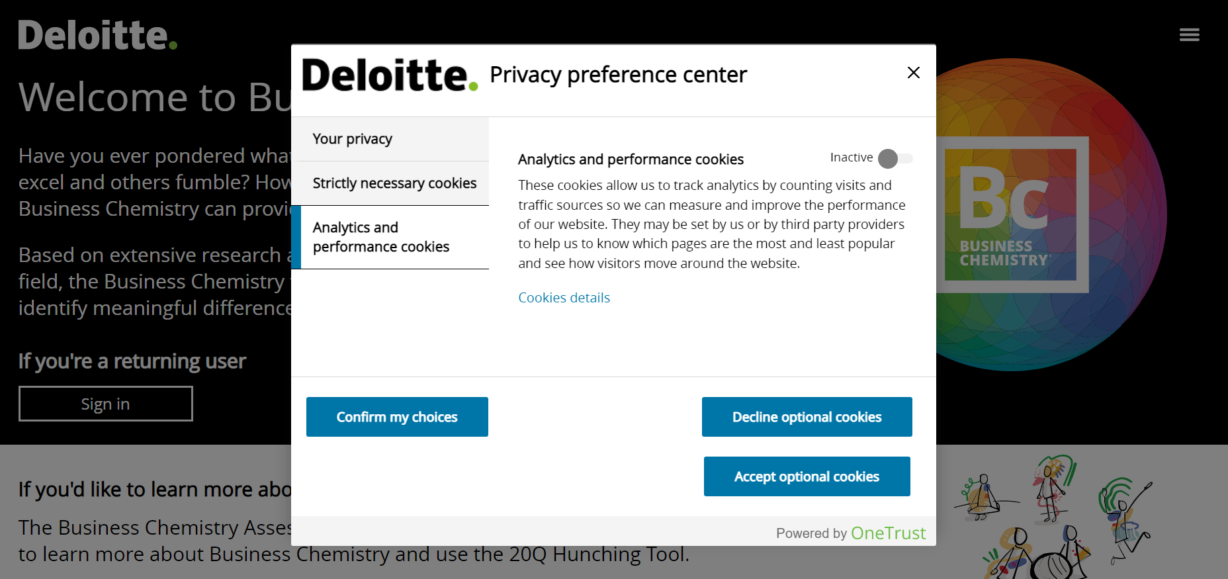
Cookie Consent Program | What does this mean for the user?
Receive users’ consent before using any cookies except those that are strictly necessary.
  Information about the existence of cookies and how they are being used
  An “opt-in” cookie consent banner presented before optional cookies can be "dropped" by the app
  The ability to continue using the app even if consent is not provided or is withdrawn
Deloitte Digital Design

Slide 8
Cookie Consent Program | Risk Prioritization Model
All sites should be prioritized in accordance with the following:
High
Public
Client-facing
Internal only
Mobile only (Currently in POC) Accessible by Deloitte and/or external visitors
Accessible to anyone with knowledge of the application’s URL
Availability of content and functionality is generally the same for visitors to the site/application
Accessible to clients (and other external visitors)
Availability of content and application functionality dependent on login access
Risk
Low
Accessible by Deloitte users only
Availability of content and application functionality generally dependent of level of access

Slide 9
Cookie Consent Program | Approach and Key Activities
The Cookie Consent program has been initiated to establish standards (in collaboration with both Global and US Privacy), evaluate organizational risk, provide tools and resources to assist and accelerate mitigation efforts.
1
2
3
Remediate/Report
Identify app scope and
evaluate risk
Onboarding by One Trust Cookie Admin team
All US managed/owned applications (web and mobile)
Phase 1: EU/UK userbase
  Phase 2: US and other member firms
Leverage OneTrust to register applications.
Perform cookie scans and cookies categorization
Provide code snippets for non-production and production environments to app teams
  Classify each app/site using the risk prioritization model
  Implement cookie banner, cookie notice and test application functionality
  Monitor and ensure cookie consent reporting available to US Privacy (and regulators if needed)

Slide 10
Meet the Teams!

Slide 11
Cookie Consent Program | Cookie Program Teams
All Member Firms
GTS Cookie Program
US Cookie Program
Procured third-party SaaS application “One Trust”. This will be the tool used by all member firms to manage - Cookie Categorization and Cookie Consent Banners
Project to ensure all US Applications with cookies comply to the use of “One Trust”. Provide a team of “Cookie Admins” to help each application team implement and sustain the management of “One Trust”
Risk and Privacy
Global and US
Teams collaborating to provide the verbiage for - Cookie Banners, Cookie Policy and Privacy Statements

Slide 12
Cookie Consent Program | Dedicated Cookie Admin Team (Audit Apps)
  AAPS team created as primary point of contact for our application teams
  Designed to navigate and support the unique needs of the AAPS organization
  Microproject within the broader US-ITS Program
  Minimize touchpoints for our product teams
  Help reduce tasks for the product teams to minimize impact to primary portfolio focus
AAPS Cookie Admin Team
Bob Faskowitz – PMO Program Manager
Bob Faskowitz – PMO Program Manager
Application Team
Product Owner
Engagement Manager
Application Architect
Rajesh Deshabatla – Engagement Manager
Rajesh Deshabatla – Engagement Manager
Christian Escobar – Project Manager
Juan Pena (Technical) – Solutions Architect
Mitali LadSowani (Functional) – BSA

Slide 13
Onboarding and Remediation
Notes:
This section is for Juan

Slide 14
Cookie Consent Program | Application remediation lifecycle (using the Service)
Remediation
PHASE
Application Discovery
Cookie Categorization
Test in NonProd
Production Cutover
Monitor
Confirm Inventory of Apps Complete Cookie Survey Provides URL’s Reviews the Scan results provided by the cookie admin team MFA enabled apps; team may need to run manual scans | Categorize cookies based on scan results confirming they are correctly aligned to the proper category ** | Test/validate Implement scripts Test cookie blocking Ensure Privacy statement and cookie notification appear as expected May need to remediate blocked functionality Might need to apply for exception to the category of a cookie i.e Omniture Validate end to end UX | Schedule go-live and provide updates to local OneTrust admin
App/Product Team
Maintain Octopus Configure URL’s in “One Trust” Perform scan of URL’s and provide results to App/product teams | Review team's cookie categorization to ensure compliance Categorize the final config of cookies in admin tool Create Test/prod scripts, provide to app teams Produce URL link and publish banner for app team | Provide scenarios to app teams to test with (Toolkit) Engage broader cookie program for any platform issues | Support for Application team Day 1 Support | Monitor progress and reporting Quarterly scans to identify changes in cookies Raise requests for “OneTrust” platform issues/enhancements
AAPS Cookie Admin Team

Slide 15
US Cookie Consent Program | Cookie Categories
ID 1
ID 2
ID 3
ID 4
ID 5
Strictly Necessary Cookies
These cookies are necessary for the website to function and cannot be switched off in our systems
Analytics & Performance Cookies
These cookies allow us to track analytics by counting visits and traffic sources so we can measure and improve the performance of our website
Functional
Cookies
    These cookies enable the website to provide enhanced functionality & personalization based on your interaction with the website
Advertising and Targeting Cookies
These cookies may be set through our site by our advertising partners
Social Media Cookies
These cookies are set by social media services that we have added to the website to enable you to share our content with your friends & networks
Note: Currently, above 5 categories are defined for now and there are no plans of adding any other categories. Anything mentioned under UNKNOWN COOKIES category needs to be re-categorized under one of the above mentioned 5 categories by the respective App Teams.

Slide 16
Cookie Consent Program | Ongoing Support
Risk and Privacy and Cookie Programs (Global and US)
Engage Vendor for any platform issues
Engage vendor for possible platform enhancements
Distribute updated information to AAPS cookie admin team
Update verbiage to; banners, privacy statement, cookie notification (If/when required)
Add cookie consent policy to TOM, SSDL and PAR for new products
Bi-monthly Global leadership reporting
Creation of ticketing process for; add, remove, modify cookie or category assignment

Slide 17
Timing and Project Management

Slide 18
Cookie Consent Program | Dates
Phased approach will be taken to remediate applications
Phase 1 – EU/UK – Hosted in or used by
RISK LEVEL | REMEDIATE BY
High (Public Facing Apps) | Feb 28, 2022
Medium (Client Facing Apps) Low (Internal Apps) | May 31, 2022
Phase 2 – US Applications – Date TBD
- Provides lead time for testing

Slide 19
Cookie Consent Program | Project Tracking
Octopus
Central location for:
  Detailed Questionnaire Responses
  Collection of all Application URL’s
  Track Status of “onboarding” and “Implementation”
  All “Knowledge Base” documents
  Data Exports

Slide 20



Cookie Consent Program | Support
Open Hours for AAPS App Teams (Q&A)
Once a week – Tuesday
Periodic Checks
Bi-weekly – Thursday
Individual touch point with App Teams
As Needed (POC – Christian Escobar)
Technical Support
As Needed (POC – Juan Pena)

Slide 21
Cookie Consent Program | Effort Estimate
* Rough estimates for effort based on a pilot of a few applications. These are directional and should be used as a guideline.
Application | Estimated effort per app (hours) | Estimated time elapsed
Large (>50 cookies) | 205 | 2-3 Months
Med (20 - 40 cookies) | 145 | 1-2 Months
Low (<20 cookies) | 93 | 1 Month

Slide 22
Q & A

Slide 23
Appendix

Slide 24
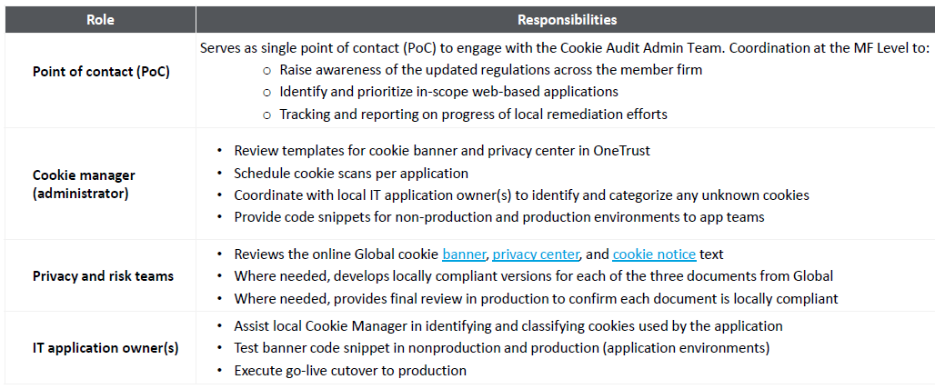
Cookie Consent Program | Resources available for Remediation Process
Remediation using the Service requires the following local resources:

Slide 25
CLASSIFICATION: CONFIDENTIAL – FOR INTERNAL USE ONLY
Deloitte refers to one or more of Deloitte Touche Tohmatsu Limited (“DTTL”), its global network of member firms, and their related entities (collectively, the “Deloitte organization”). DTTL (also referred to as “Deloitte Global”) and each of its member firms and related entities are legally separate and independent entities, which cannot obligate or bind each other in respect of third parties. DTTL and each DTTL member firm and related entity is liable only for its own acts and omissions, and not those of each other. DTTL does not provide services to clients. Please see www.deloitte.com/about to learn more.
This communication and any attachment to it is for internal distribution among personnel of Deloitte Touche Tohmatsu Limited (“DTTL”), its global network of member firms and their related entities (collectively, the “Deloitte organization”). It may contain confidential information and is intended solely for the use of the individual or entity to whom it is addressed. If you are not the intended recipient, please notify us immediately by replying to this email and then please delete this communication and all copies of it on your system. Please do not use this communication in any way.
None of DTTL, its member firms, related entities, employees or agents shall be responsible for any loss or damage whatsoever arising directly or indirectly in connection with any person relying on this communication. DTTL and each of its member firms, and their related entities, are legally separate and independent entities.
© 2021. For information, contact Deloitte Global.

